Slide 1
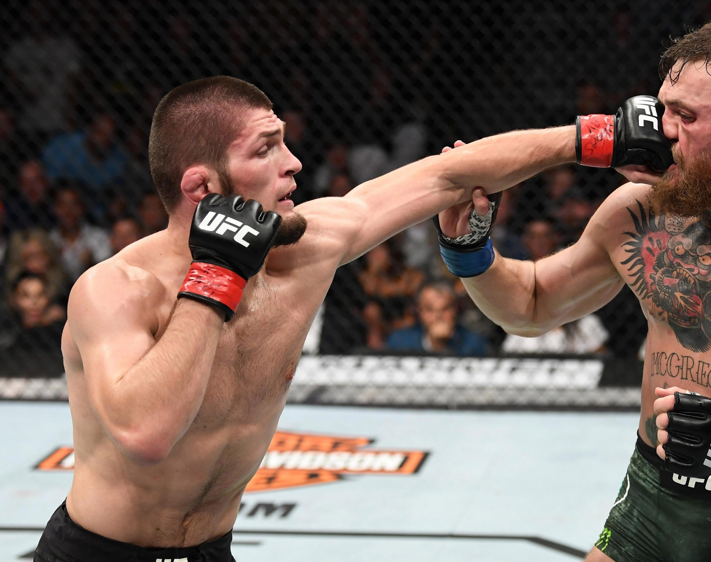
Optimizing sportsbook betting odds for UFC fights
Kester Chia

Slide 2
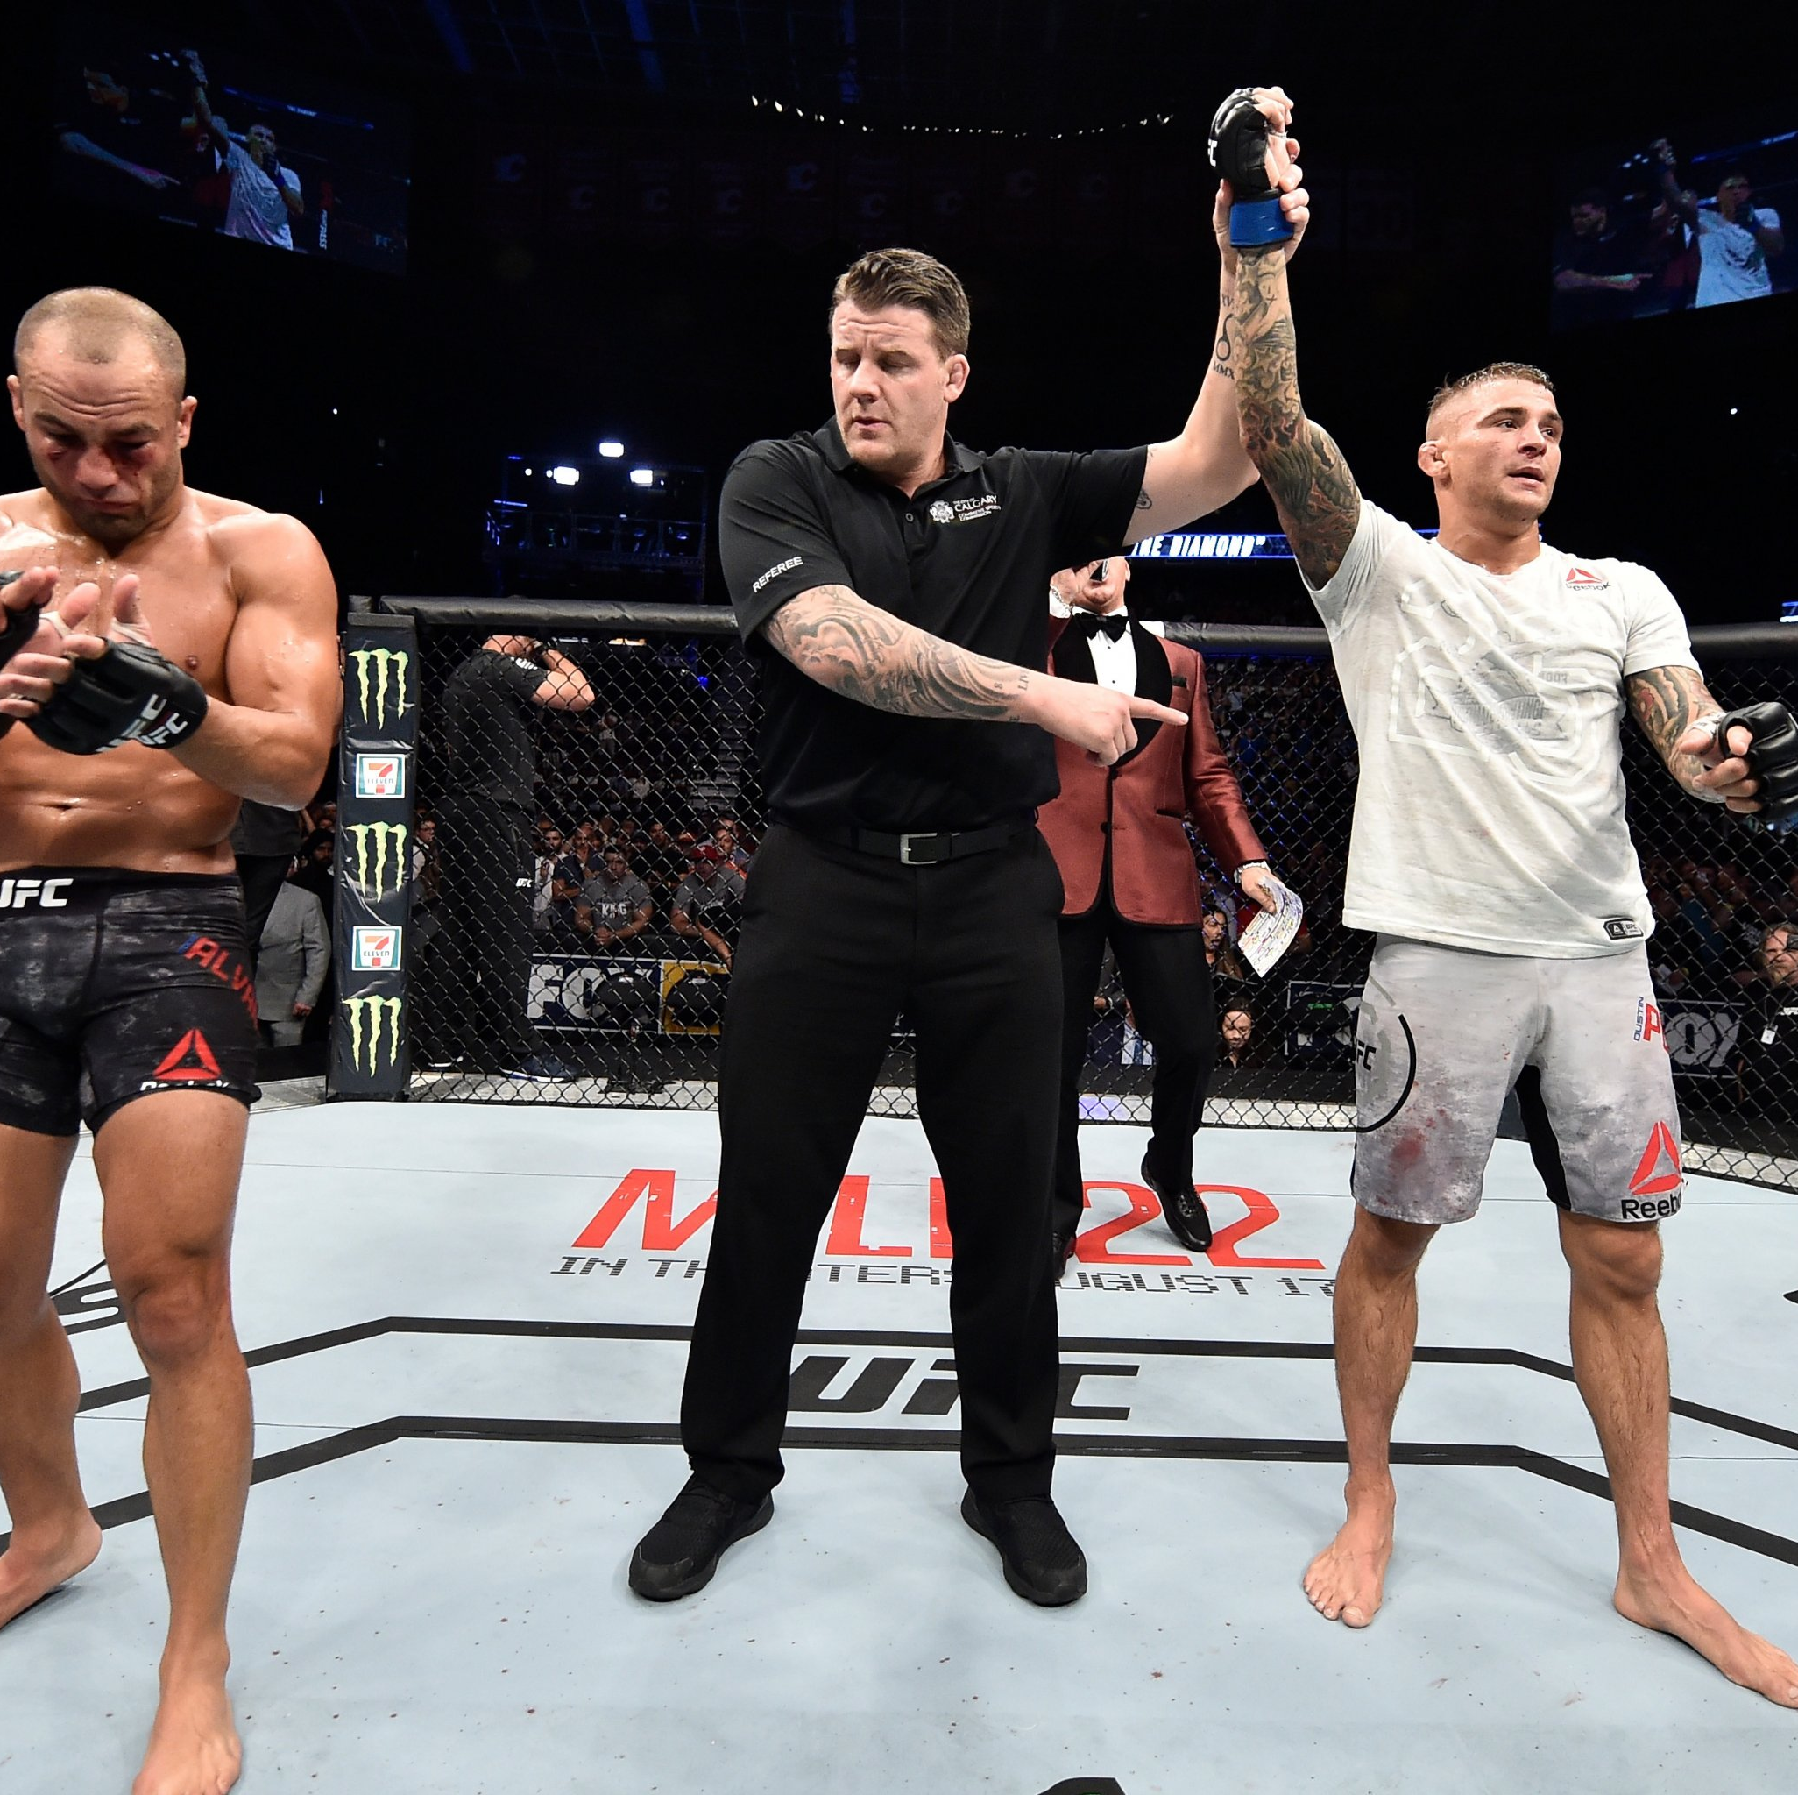
What is UFC?
The Ultimate Fighting Championship is a mixed martial arts (MMA) company which hosts fights
Fights are always between two fighters in a cage
Fights continue until a knockout (KO) is achieved or the last round is over.
Draws almost never happen in UFC fights

Slide 3
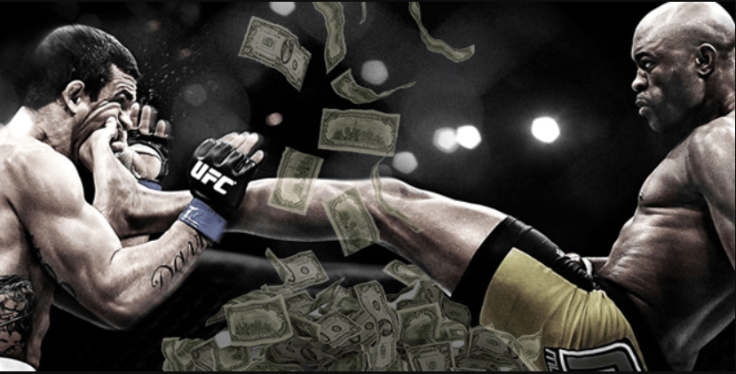
Gambling in UFC Fights
Fight betting is a huge industry, with a variety of betting companies offering competitive rates
Involves huge amounts of money: online betting market is worth 58.9bn USD

Slide 4
More on Gambling Odds
For every betting site, the fight odds are based on predictions on who the winner will be
The more likely a fighter is predicted to win, the lower his odds will be placed to discourage people from betting on him and vice versa.
An example for illustration:

Slide 5
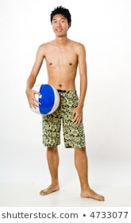
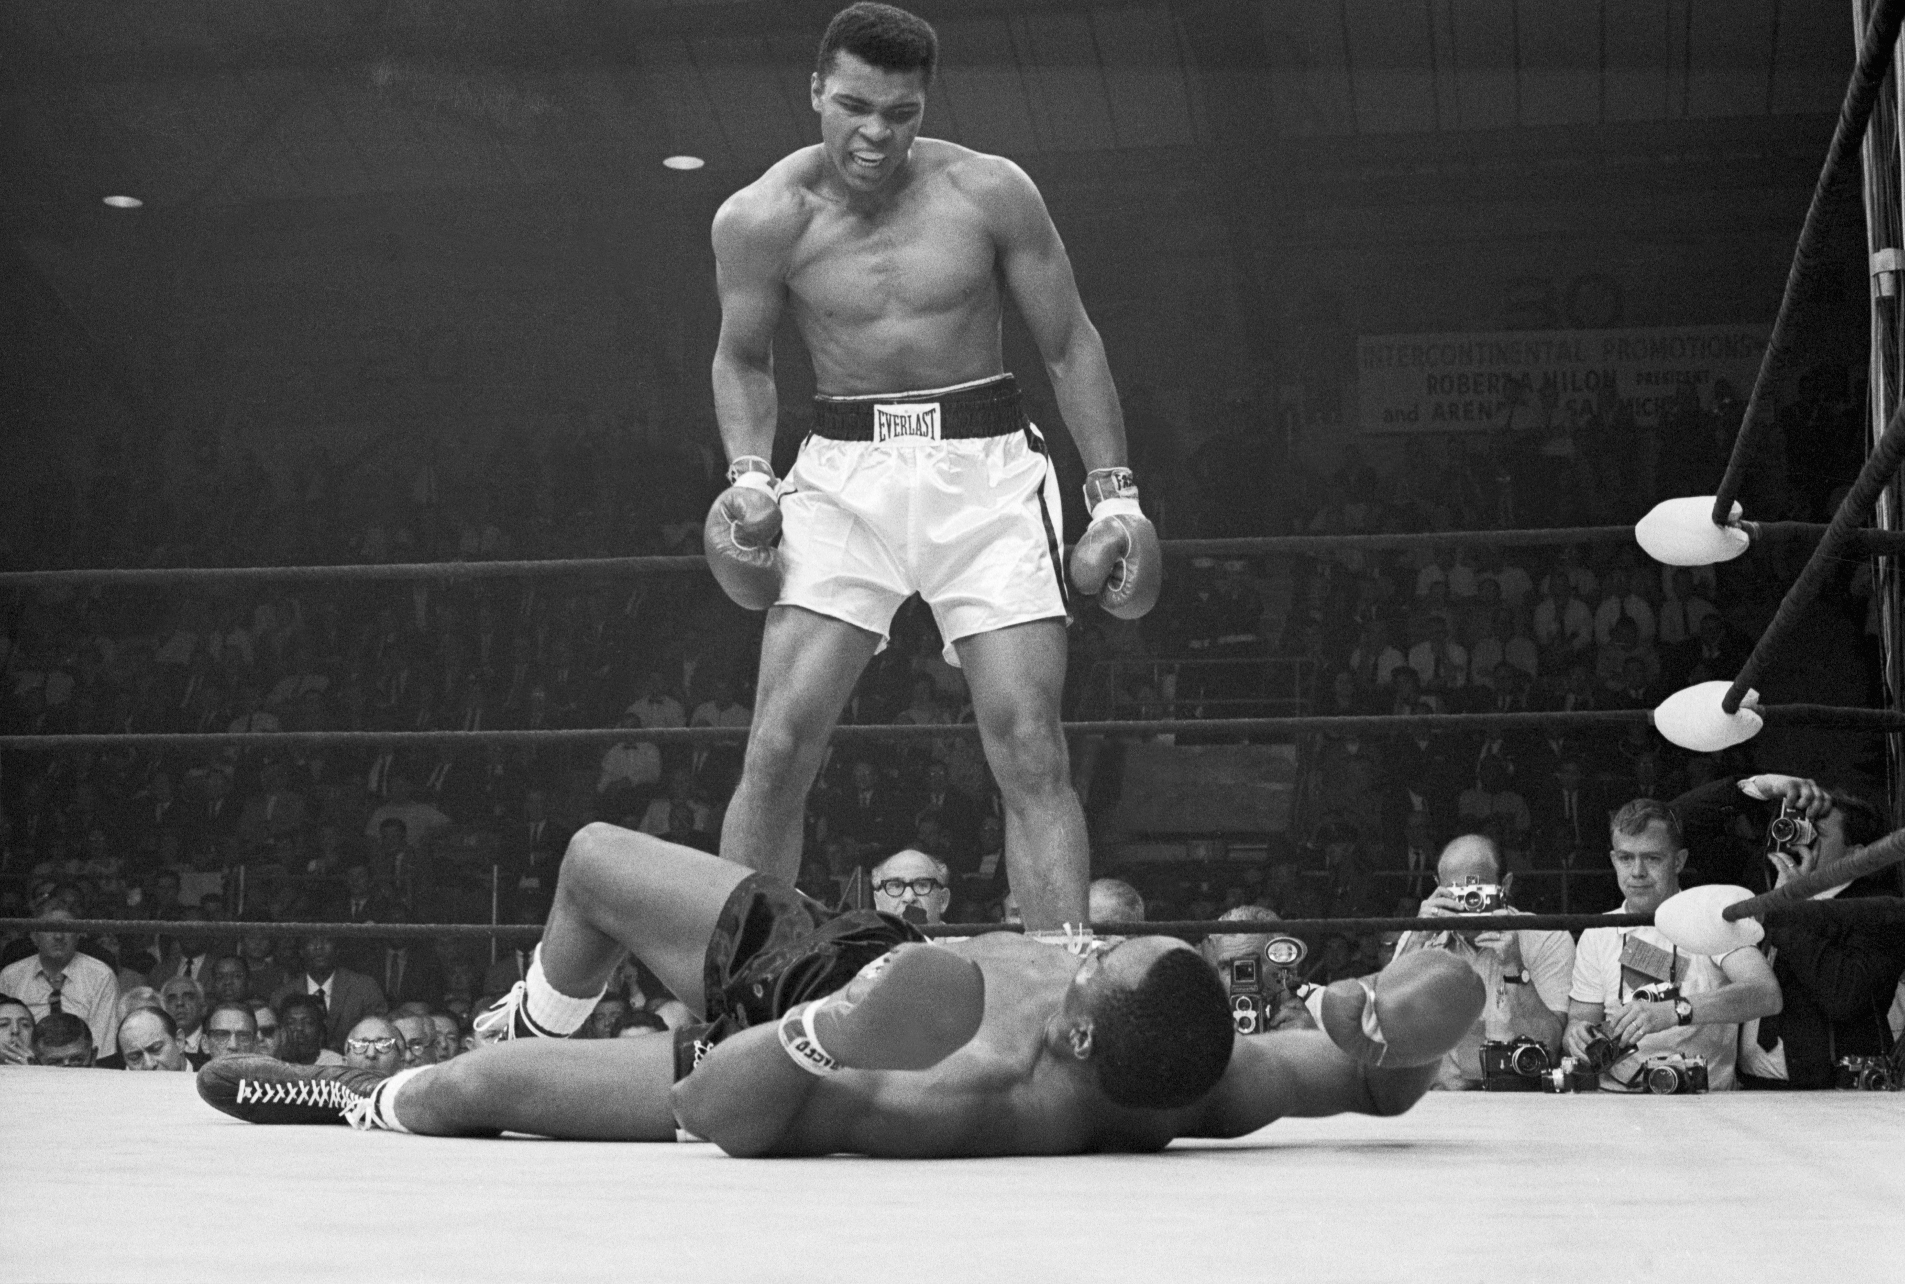
More on Gambling Odds
For every betting site, the fight odds are based on predictions on who the winner will be
The more likely a fighter is predicted to win, the lower his odds will be placed to discourage people from betting on him and vice versa.
An example for illustration:
Muhammad Ali vs. Kester Chia
(-4000)
(+10,000)

Slide 6
More on Gambling Odds
Risks organizers face:
Setting odds too low (too conservative):
Low consumer demand for bets; bets simply not worth the risk to bettors
Setting odds too high (too confident):
Losses for the betting site, bettors are winning more than they are losing.
Predicting the wrong winner:
The worst possible outcome, and the organizers will make a significant loss
In fact, later analysis will reveal they get the winner wrong ~35% of the time!

Slide 7
More on Gambling Odds
Fights getting more difficult to predict because of fighters “padding” their win records
Fighters with a 15-0 win record may not be as strong as a 10-5 fighter
Many fights for every event; analyzing each upcoming fight individually takes a significant amount of time
Can we develop a model to optimize betting odds in order to:
More reliably predict the winner,
Quickly determine betting odds, saving resources and time,
Reduce risk to the betting site, and
Maximize profits?

Slide 8
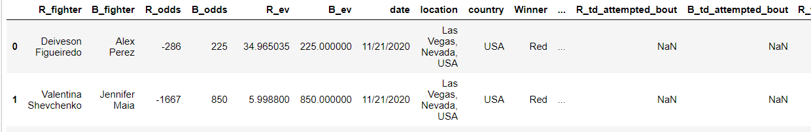
Dataset
Source: https://www.kaggle.com/mdabbert/ultimate-ufc-dataset?select=ufc-master.csv
Dataset consists of information for every UFC fight since 2010
That’s about ~4500 fights with 108 variables, including fighter styles, takedown rates, etc.

Slide 9
1. Basic EDA

Slide 10
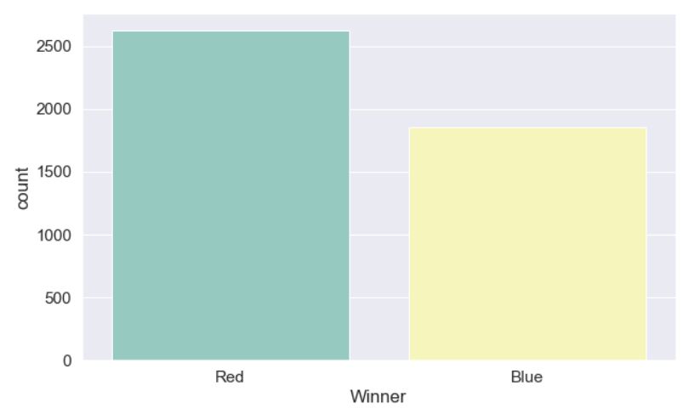
1. Basic EDA
Dataset is well balanced between the Red/Blue corner winning
In general, the red corner tends to be the fight favourite

Slide 11
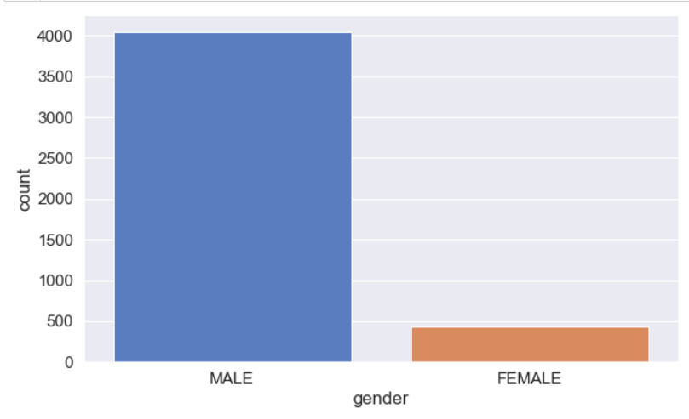
1. Basic EDA
Male fights are a lot more common than female fights, which is expected since MMA is male-dominated
Model must be able to generalize across fights from both genders

Slide 12
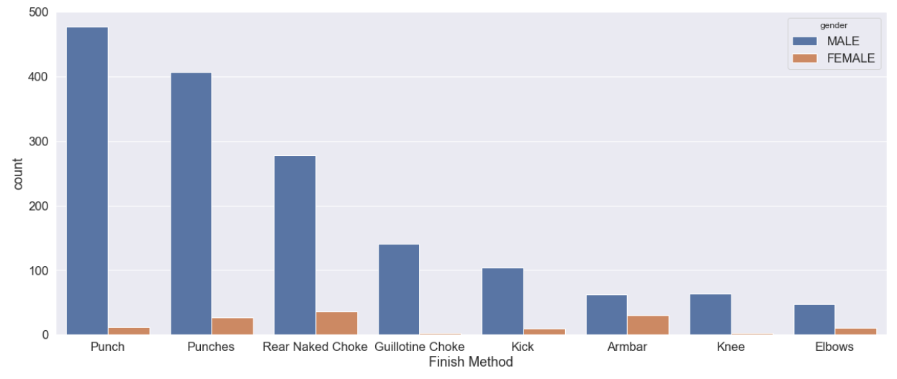
1. Basic EDA
One example where males are very different from females - the type of finishes
Males tend to have more success with knockout finishes, whereas females have more success with submission finishes

Slide 13
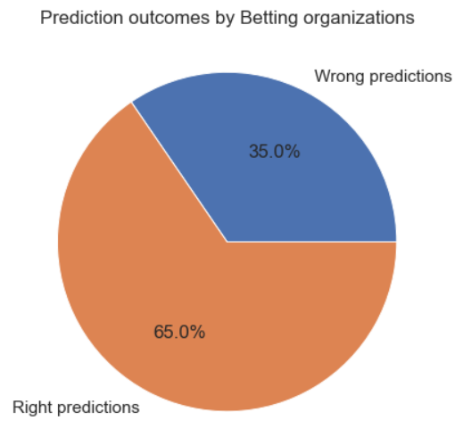
1. Basic EDA
Betting organizations only get fight predictions right 65% of the time!
On the 35% that they get wrong, the gambling odds are many deviations from the optimum, and they suffer significant losses

Slide 14
2. Data Cleaning

Slide 15
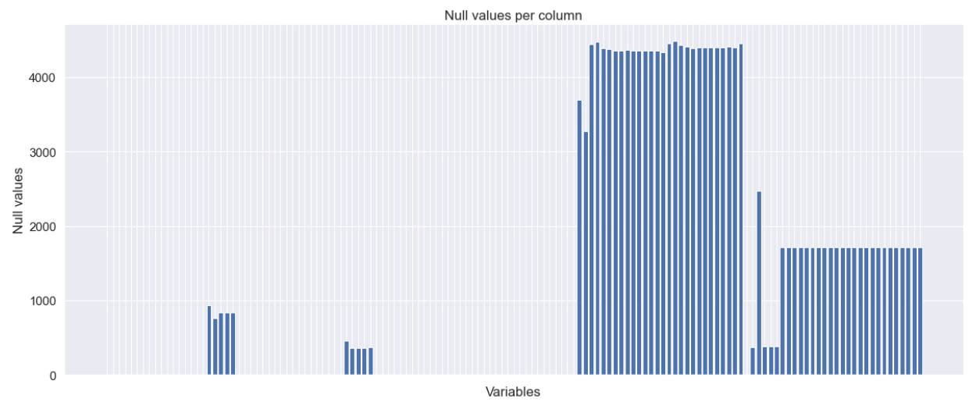
2. Data Cleaning
Significant number of null values present in the data
Imputing categorical variables:
Simple imputer replacing null values with category modes
Imputing numerical variables:
Iterative imputer; uses Bayesian Ridge Regression to impute null values based on other variables.
Iterates over each variable in a round-robin fashion until all columns are imputed

Slide 16
2.1: Data Preprocessing:
Encoded categorical variables
Binary Encoding instead of Dummy, reducing dimensionality
Scaled numerical variables
Robust scaler used as some variables exhibit significant skew
Principle Component Analysis (PCA) decomposition performed
56 out of 140 components kept, explaining 95% of total data variance
Recursive Feature Elimination (RFE) performed
Pruned PCA components from 56 down to 30

Slide 17
3. Model Implementation

Slide 18
3. Model implementation:
Models
Simple Models:
Logistic regression
Support vector machines
K-Nearest neighbors
Ensemble Models:
Random Forest
Stacked Classifier (of the four simple models above)
AdaBoost
Neural Networks:
Dense, Fully connected NN
Tuning
GridSearchCV
Keras Tuner with HyperBand algorithm

Slide 19
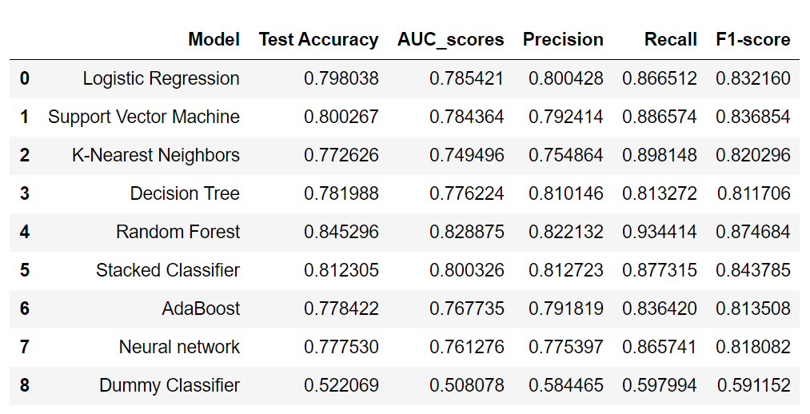
3. Model implementation:
Results:

Slide 20
3. Model implementation:
Random forest parameters:
No. of trees = 400
Unlimited max tree depth
Criterion for splits: Gini impurity
Bootstrap sampling used for each tree
Equal weights given to both classes

Slide 21
4. Model evaluation

Slide 22
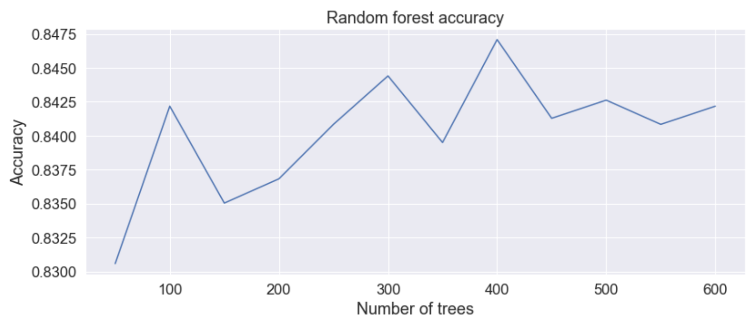
4. Evaluation
The model accuracy is best at 400 trees, but performs almost as well at 100 trees
Choosing 100 trees instead is plausible if runtime is an issue

Slide 23
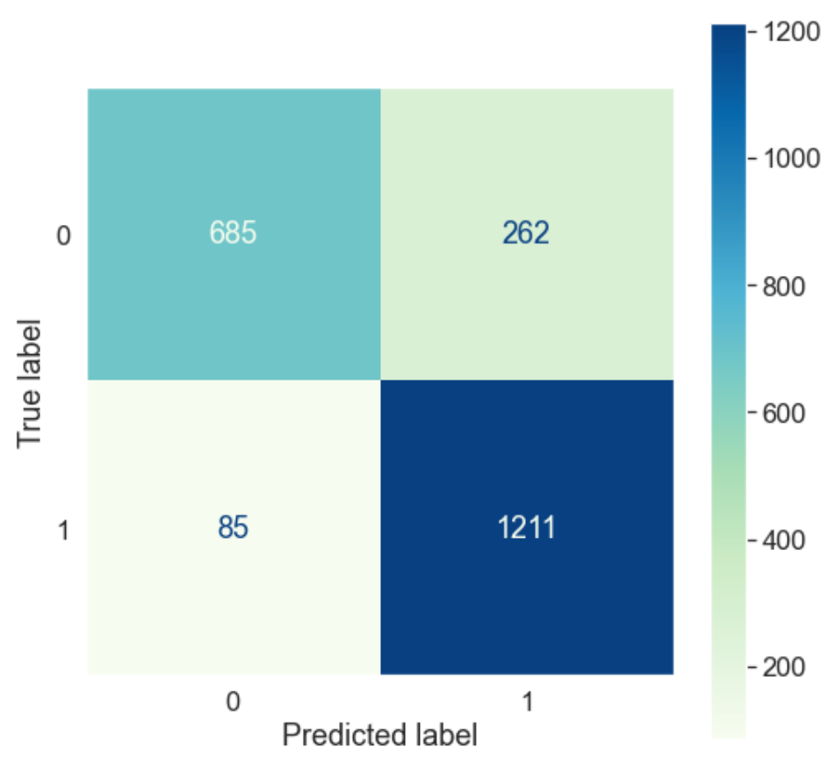
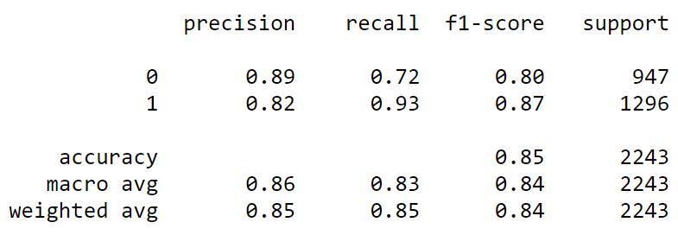
4. Evaluation
Evaluation for the best-performing Random Forest model
The target label 1 refers to the Red corner winning
The model seems to favor the red corner, with a recall of 0.93

Slide 24
5. Creating a tool to optimize betting odds

Slide 25
5. Creating a tool to optimise betting odds
Here we make a tool to optimise the betting odds based on predicted win probability of each fighter
Since a random forest model cannot produce easily interpretable probabilities, we need to calibrate the model
After creating a calibrated model, we need a function to:
Predict the winner, based on the fight history of both fighters
Output optimal betting odds

Slide 26
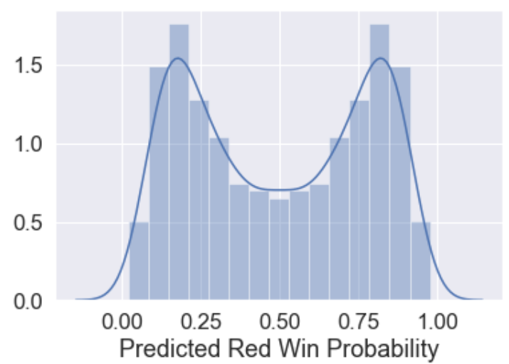
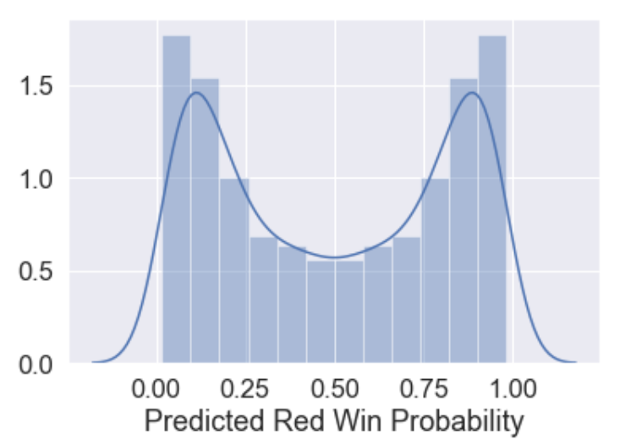
5.1: Calibrating a probability model
The RF model was calibrated using sklearn’s CalibratedClassifierCV, fitting the probability distribution to a sigmoid function
RF Model before calibration
RF Model after calibration

Slide 27

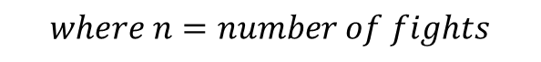
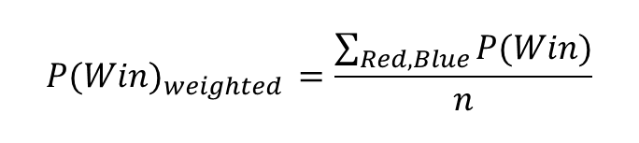
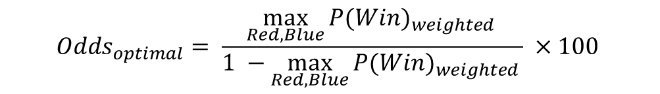

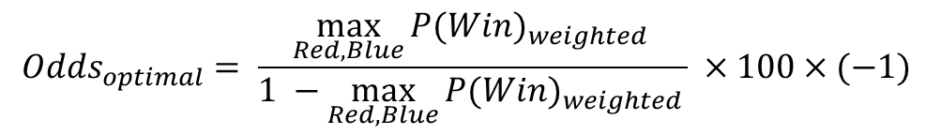
5.2: Creating a function to output optimal odds
$${P(Win)}_{weighted }=\frac{\sum_{Red,Blue}{P(Win)}}{n}$$
$$For {P(Win)}_{weighted }≥0.5:$$
$${Odds}_{optimal}= \frac{\max_{Red,Blue}{{P(Win)}_{weighted }}}{1 −\max_{Red,Blue}{{P(Win)}_{weighted }}} ×100×(−1)$$
$$For {P(Win)}_{weighted }<0.5:$$
$${Odds}_{optimal}= \frac{\max_{Red,Blue}{{P(Win)}_{weighted }}}{1 −\max_{Red,Blue}{{P(Win)}_{weighted }}} ×100$$
$$where n=number of fights$$

Slide 28
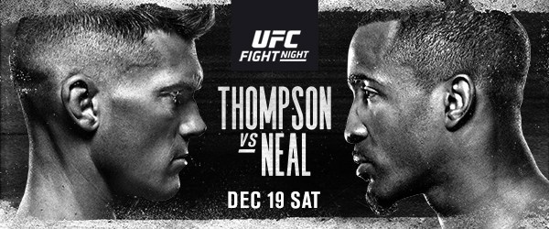
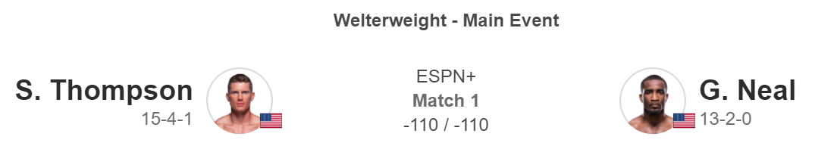
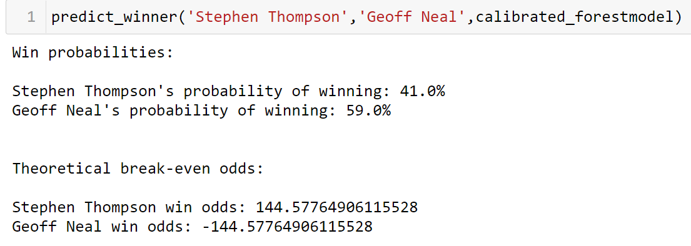
5.3: Finished product in code:

Slide 29
6. Final thoughts

Slide 30
6. Final thoughts:
Advantages
Much higher accuracy than a baseline dummy classifier
Useful for betting sites to quickly get the optimal betting odds for upcoming fights
Save resources and time
Random forest can easily identify which variables contribute the most to winning

Slide 31
6. Final thoughts:
Weaknesses
Model assumes equal demand for the underdog and favorite
In reality this is never the case; more competitive odds must typically placed on the underdog to attract demand for bets
Cannot predict outcomes for new fighters
The function calculates the averages of all previous fights
Without any fight history, the function doesn’t have enough input

Slide 32
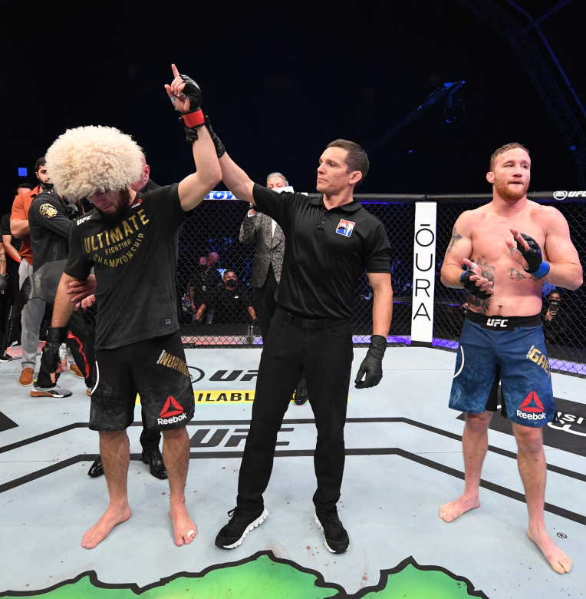
End

